Slide 1
CS 341 Lab introduction
Fall 2020

Slide 2
Weekly Meetings
Starter code is available on GitHub: https://github.com/jack17davis/cs341
Lab introduction
Working lab demonstration
Q&A
Breakout rooms for real-time labs
Use the “help” button to get my attention
You are welcome to take longer or leave early
Lab report is due by the start of the next lab (typically a week)

Slide 3
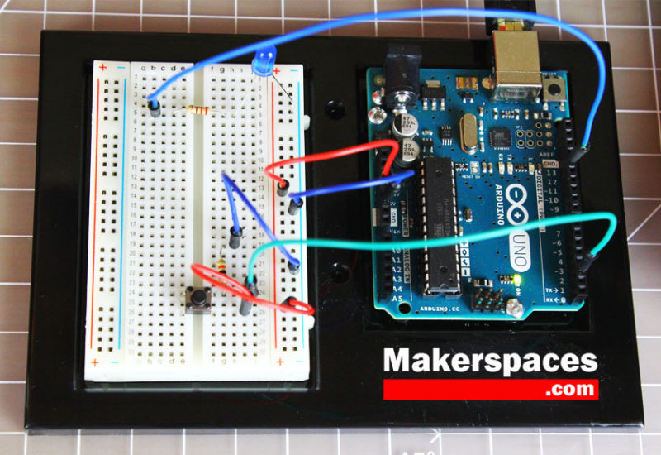
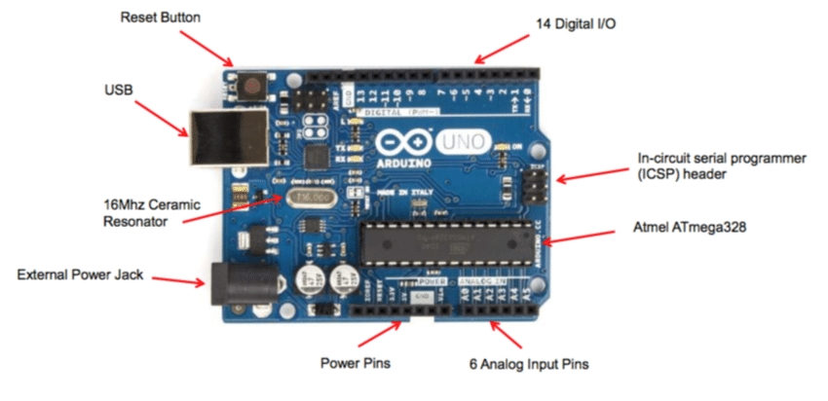
Arduino

Slide 4
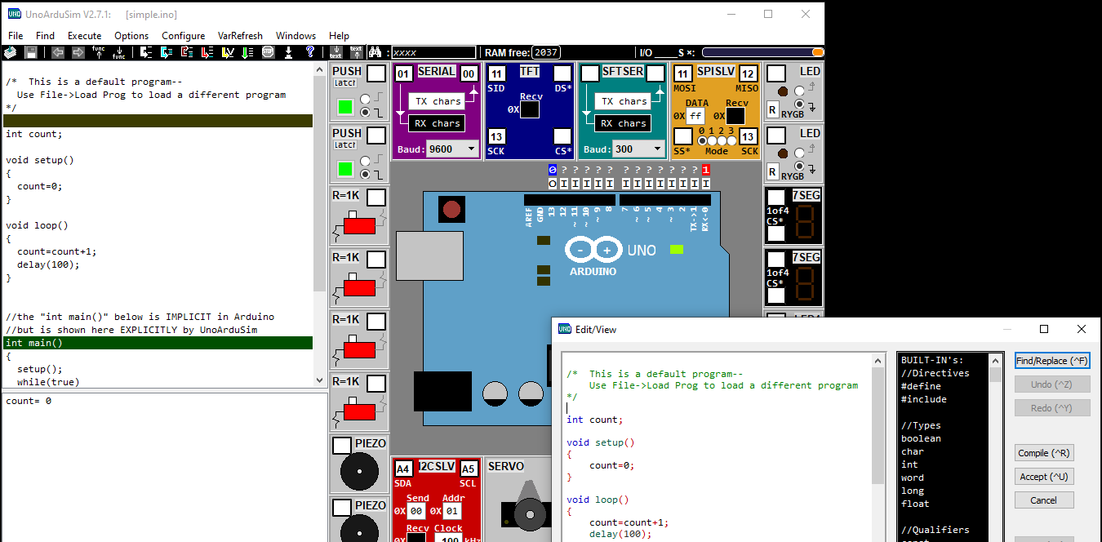

Slide 5
Lab Report Template
Need some bullets here
Due date, etc
Need Photo here

Slide 6
Policies
Work in groups of 1 or 2
Post lab questions on Piazza with lab tag (privately if you need to share code)
Email me for grades or if you would like to setup a 1:1 meeting (jack.davis001@umb.edu)
1 makeup lab is allowed for the semester (due by 11:59PM on December 11th)

Slide 7
Lab 1

